Slide 1




Development of master curricula for natural disasters risk management in
Western Balkan countries
NatRisk
WP6: Dissemination activities
Dejan Rančić
University of Niš, Faculty of Electronic Engineering
Workshop on master curricula best practices in EU partners / 5th to 7th April 2017.
Project number: 573806-EPP-1-2016-1-RS-EPPKA2-CBHE-JP
"This project has been funded with support from the European Commission. This publication reflects the views only of the author, and the Commission cannot be held responsible for any use which may be made of the information contained therein"

Slide 2
Activities and achievements
Development of master curricula for natural disasters risk management in Western Balkan countries
Outputs/ outcomes – LFM code | Indicator | Achieved to date | Comment
6.1 Dissemination plan created | - Dissemination plan | - Strategy for dissemination activities is defined - Dissemination methods, tools and channels are defined - Target groups are identified - Key messages are identified - Dissemination calendar is created | Finished by 07/03/2017
6.2 Promotion material created | - Web site - Promotion material | - Web site is created - Facebook profile is created - LinkedIn profile is created - Project's logo is designed - Promotion material is printed and distributed (brochure, poster, rollup, folder, notebook, pencil) - Project management platform is developed | Finished by 09/12/2016

Slide 3
Development of master curricula for natural disasters risk management in Western Balkan countries
6.1 Dissemination Plan
Dissemination is one of the core activities of the NatRisk project to ensure successful realisation of planned activities (student enrolment in new master study programmes and trainees) and for project sustainability.
The activities related to dissemination are started from the very beginning of the project, and it is planed to continue during project realization and after its completion as a permanent process which is important to raise the awareness of including new experts to strength NDRM (Natural Disasters Risk Management) systems in WB (Western Balkan) countries.

Slide 4
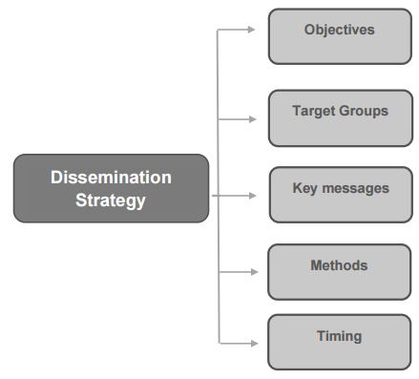
Development of master curricula for natural disasters risk management in Western Balkan countries
Dissemination strategy
The dissemination strategy defines clear guidelines for the dissemination activities including all operational elements of dissemination.

Slide 5
Development of master curricula for natural disasters risk management in Western Balkan countries
Dissemination objectives
The dissemination objectives of NatRisk projects are to:
identify target groups at different territorial levels: national, regional, EU;
identify the communication needs of the target groups;
establish core messages of the project, to be disseminated to the target groups;
identify dissemination methods and tools;
disseminate the results, solutions and knowledge collected within a project to the general audience;
define timing of dissemination activities;
define partners’ responsibilities in dissemination activities.

Slide 6
Development of master curricula for natural disasters risk management in Western Balkan countries
Target groups
The primary goal of NatRisk project is to educate experts for NDRM in WB partner countries.
The scope of the project results in a variety of target groups:
  students of bachelor studies related to NDRM,
  WB teaching staff,
  representatives of bodies and agencies for environmental protection and
  managers and engineers from non-academic and public sectors in WB countries.

Slide 7
Development of master curricula for natural disasters risk management in Western Balkan countries
Key messages
The principle guidelines of key messages are to:
  be clear, simple and easy to understand.
  tailored to the target groups
  information should be correct and realistic.
The key messages are:
  Management of natural disasters became the greatest global challenge and an indispensable requirement for sustainable development,
  New educated professionals in the field of natural disasters risk management,
  Trained citizens to cope efficiently with natural disasters.

Slide 8
Development of master curricula for natural disasters risk management in Western Balkan countries
Calendar of dissemination events
Deadline | Event type | Document type | Responsible partner
15-16 December 2016 | Kick-off meeting - Nis | News - Annex W | P1 - UNI
 |  | Event - Annex X
 |  | Agenda - Annex C
 |  | List of participants - Annex D
 |  | Minutes - Annex A
 |  | Event report - Annex F
 |  | Evaluation lists - Annex E
 |  | Gallery

Slide 9
Development of master curricula for natural disasters risk management in Western Balkan countries
Deadline | Event type | Document type | Responsible partner
04-08 April 2017 | Workshop on master curricula best practices in EU countries - Vienna | News - Annex W | P2 - BOKU
 |  | Event - Annex X
 |  | Agenda - Annex C
 |  | List of participants - Annex D
 |  | Event report - Annex F
 |  | Presentations - Annex B
 |  | Evaluation lists - Annex E
 |  | Gallery
04-08 April 2017 | First SC meeting- Vienna | News - Annex W | P2 - BOKU
 |  | Event - Annex X
 |  | Agenda - Annex C
 |  | List of participants - Annex D
 |  | Minutes of the meetings - Annex A
 |  | Event report - Annex F
 |  | Presentations - Annex B
 |  | Evaluation lists - Annex E Risk monitoring form – Annex K
 |  | Gallery
04-08 April 2017 | First PMC meeting- Vienna | News - Annex W | P2 - BOKU
 |  | Event - Annex X
 |  | Agenda - Annex C
 |  | List of participants - Annex D
 |  | Minutes of the meetings - Annex A
 |  | Event report - Annex F
 |  | Presentations - Annex B
 |  | Evaluation lists - Annex E
 |  | Gallery
04-08 April 2017 | First QAC meeting - Vienna | News - Annex W | P2 - BOKU
 |  | Event - Annex X
 |  | Agenda - Annex C
 |  | List of participants - Annex D
 |  | Minutes of the meetings - Annex A
 |  | Event report - Annex F
 |  | Presentations - Annex B

Slide 10
Development of master curricula for natural disasters risk management in Western Balkan countries
Deadline | Event type | Document type | Responsible partner
May 2017 | Training of teaching staff | News - Annex W | P10 - OE
 |  | Event - Annex X
 |  | Agenda - Annex C
 |  | List of participants - Annex D
 |  | Event report - Annex F
 |  | Presentations - Annex B
 |  | Evaluation lists - Annex E
 |  | Gallery
May 2017 | Study visit | News - Annex W | P10 - OE
 |  | Event - Annex X
 |  | Agenda - Annex C
 |  | List of participants - Annex D
 |  | Event report - Annex F
 |  | Presentations - Annex B
 |  | Evaluation lists - Annex E
 |  | Gallery
June 2017 | Training of teaching staff | News - Annex W | P3 – MUHEC
 |  | Event - Annex X
 |  | Agenda - Annex C
 |  | List of participants - Annex D
 |  | Event report - Annex F
 |  | Presentations - Annex B
 |  | Evaluation lists - Annex E
 |  | Gallery
June 2017 | Study visit | News - Annex W | P3 - MUHEC
 |  | Event - Annex X
 |  | Agenda - Annex C
 |  | List of participants - Annex D
 |  | Event report - Annex F
 |  | Presentations - Annex B
 |  | Evaluation lists - Annex E
 |  | Gallery
July 2017 | Training of teaching staff | News - Annex W | P13 – TUC
 |  | Event - Annex X
 |  | Agenda - Annex C
 |  | List of participants - Annex D
 |  | Event report - Annex F
 |  | Presentations - Annex B
 |  | Evaluation lists - Annex E
 |  | Gallery
July 2017 | Study visit | News - Annex W | P13 - TUC
 |  | Event - Annex X
 |  | Agenda - Annex C
 |  | List of participants - Annex D
 |  | Event report - Annex F
 |  | Presentations - Annex B
 |  | Evaluation lists - Annex E
 |  | Gallery

Slide 11
Development of master curricula for natural disasters risk management in Western Balkan countries
Deadline | Event type | Document type | Responsible partner
September 2017 | Training of teaching staff | News - Annex W | P9 - UNIME
 |  | Event - Annex X
 |  | Agenda - Annex C
 |  | List of participants - Annex D
 |  | Event report - Annex F
 |  | Presentations - Annex B
 |  | Evaluation lists - Annex E
 |  | Gallery
September 2017 | Study visit | News - Annex W | P9 - UNIME
 |  | Event - Annex X
 |  | Agenda - Annex C
 |  | List of participants - Annex D
 |  | Event report - Annex F
 |  | Presentations - Annex B
 |  | Evaluation lists - Annex E
 |  | Gallery
September 2017 | Second SC meeting- Messina | News - Annex W | P9 - UNIME
 |  | Event - Annex X
 |  | Agenda - Annex C
 |  | List of participants - Annex D
 |  | Minutes of the meetings - Annex A
 |  | Event report - Annex F
 |  | Presentations - Annex B Evaluation lists - Annex E Risk monitoring form – Annex K
 |  | Gallery
September 2017 | Second PMC meeting-Messina | News - Annex W | P9 - UNIME
 |  | Event - Annex X
 |  | Agenda - Annex C
 |  | List of participants - Annex D
 |  | Minutes of the meetings - Annex A
 |  | Event report - Annex F
 |  | Presentations - Annex B Evaluation lists - Annex E
 |  | Gallery
September 2017 | Second QAC meeting - Messina | News - Annex W | P9 - UNIME
 |  | Event - Annex X
 |  | Agenda - Annex C
 |  | List of participants - Annex D
 |  | Minutes of the meetings - Annex A
 |  | Event report - Annex F
 |  | Presentations - Annex B
 |  | Evaluation lists - Annex E Gallery

Slide 12
Development of master curricula for natural disasters risk management in Western Balkan countries
Deadline | Event type | Document type | Responsible partner
November 2017 | Training of teaching staff | News - Annex W | P2 – BOKU
 |  | Event - Annex X
 |  | Agenda - Annex C
 |  | List of participants - Annex D
 |  | Event report - Annex F
 |  | Presentations - Annex B
 |  | Evaluation lists - Annex E
 |  | Gallery
November 2017 | Study visit | News - Annex W | P2 – BOKU
 |  | Event - Annex X
 |  | Agenda - Annex C
 |  | List of participants - Annex D
 |  | Event report - Annex F
 |  | Presentations - Annex B
 |  | Evaluation lists - Annex E
 |  | Gallery

Slide 13
6.2 Visual identity (promotion material)
Development of master curricula for natural disasters risk management in Western Balkan countries
Project Logo
Project web site
Social network profiles
Promotion material

Slide 14




Project logo
Development of master curricula for natural disasters risk management in Western Balkan countries

Slide 15
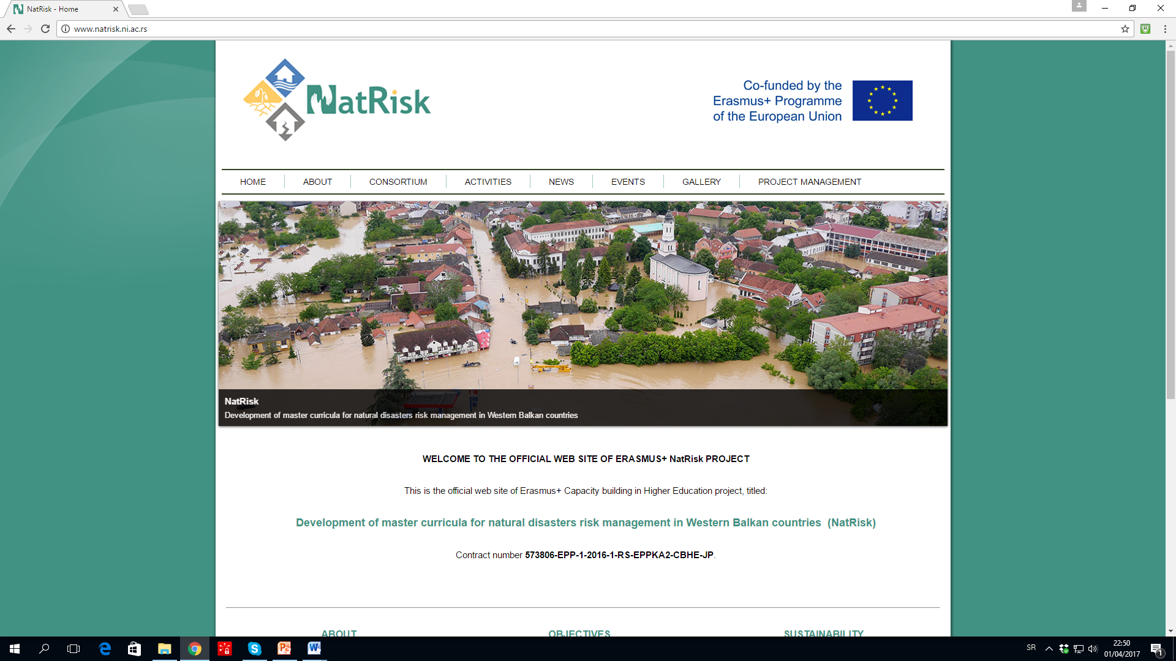
Development of master curricula for natural disasters risk management in Western Balkan countries
NatRisk website
www.natrisk.ni.ac.rs

Slide 16
Social network profile - FB
Development of master curricula for natural disasters risk management in Western Balkan countries

Slide 17
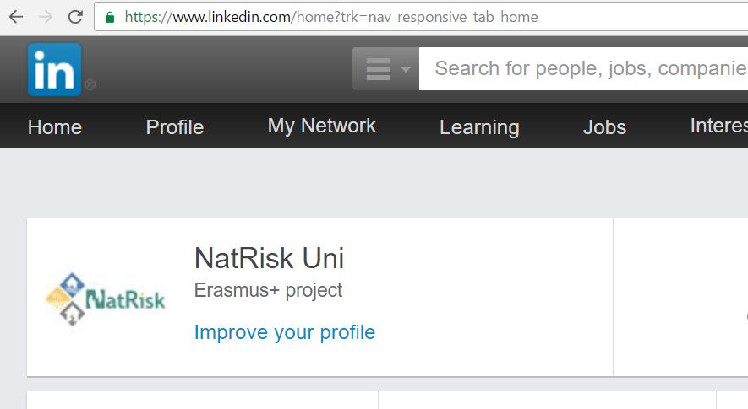
Social network profile - LinkedIn
Development of master curricula for natural disasters risk management in Western Balkan countries

Slide 18
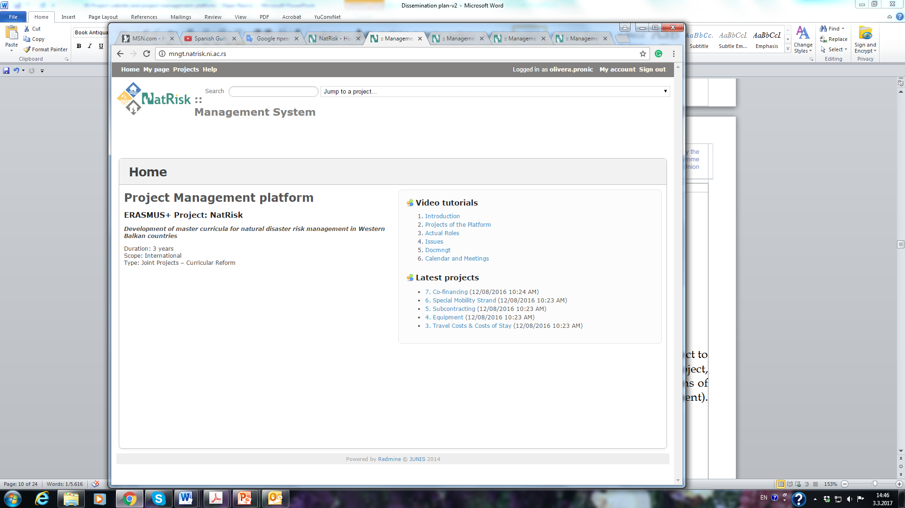
Development of master curricula for natural disasters risk management in Western Balkan countries
Project Management Platform

Slide 19




Promotion material
Development of master curricula for natural disasters risk management in Western Balkan countries

Slide 20
Development of master curricula for natural disasters risk management in Western Balkan countries
Project brochure

Slide 21
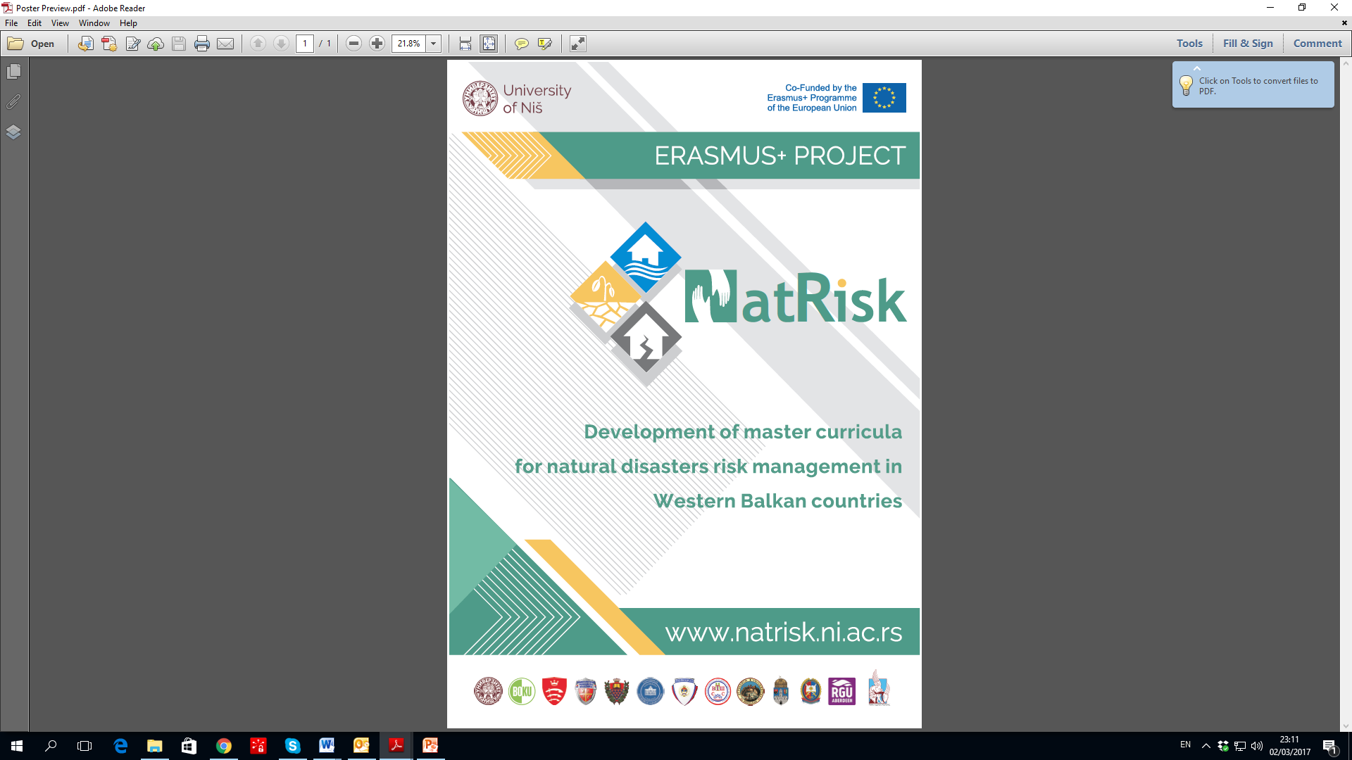
Development of master curricula for natural disasters risk management in Western Balkan countries
Poster

Slide 22
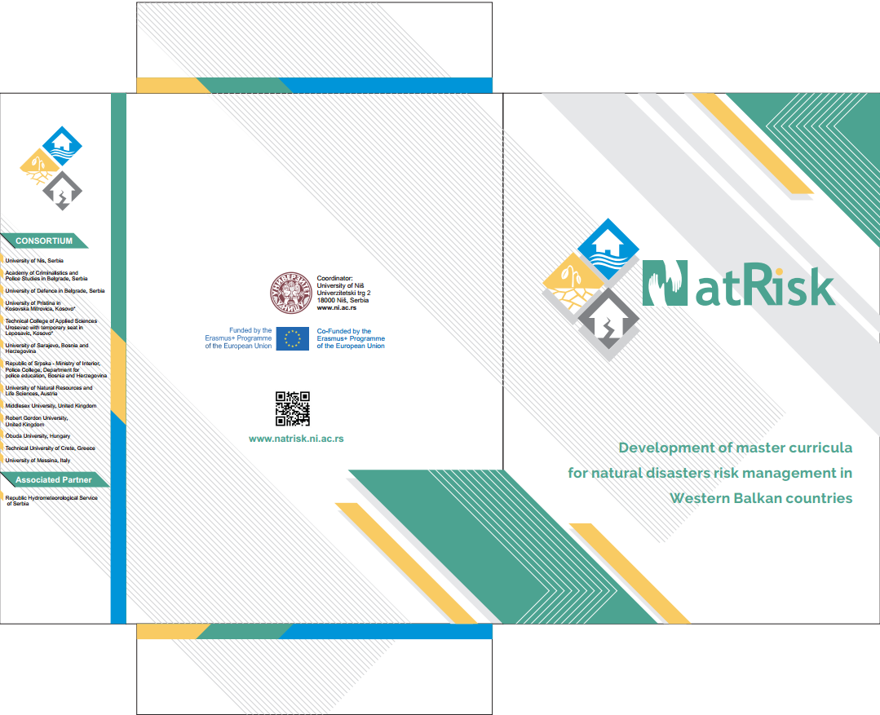
Development of master curricula for natural disasters risk management in Western Balkan countries
Folder

Slide 23
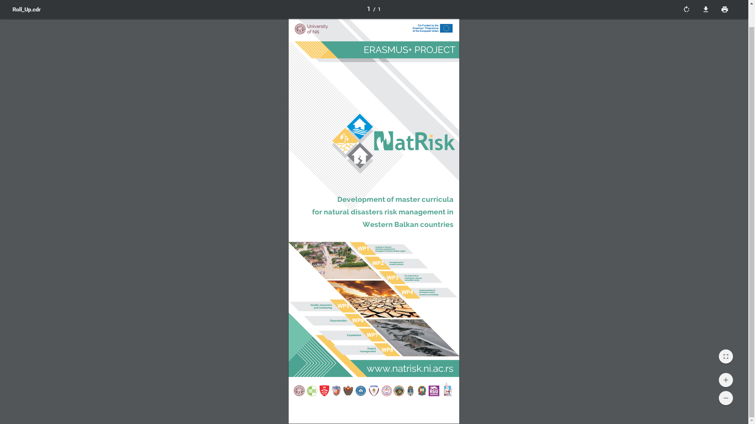
Development of master curricula for natural disasters risk management in Western Balkan countries
Rollup

Slide 24
Conclusion
Development of master curricula for natural disasters risk management in Western Balkan countries
LFM matrix specifies following objective indicators for dissemination:
  Web site developed since November 2016 – accomplished.
  Dissemination Plan created by March 2017 - accomplished.
  Promotion material created since March 2017 - accomplished.
According to these indicators, it can be concluded that dissemaination activities are performed successfuly and on time.

Slide 25
Thanks for your attention!!!
Development of master curricula for natural disasters risk management in Western Balkan countries

